Slide 1
Smart OLA Ride
Team : TrailBlazers
Pranav, Praveen, Amit

Slide 2
Problem Statement
While travelling, users would want to perform tasks on their way so that they avoid travelling to and fro. What if the app could smartly determine the tasks that the user has to perform for the day, and help him do them during his ride!
Sometimes customers are unaware and not able to fully utilize OLA Café and OLA Store services as compared to OLA ride.

Slide 3
Use cases
Have breakfast/lunch/dinner while you are riding.
Pickup parcels, laundry, groceries on your way
Get reminded of your tasks, ocassions & people important to you, and PLAN while riding
Know more about OLA and their services!

Slide 4
Solution
Integrate the OLA Ride with OLA Café and OLA Store and create a better user experience.
Advantages: Utilize all current & upcoming OLA Services on the way, which also acts creates awareness via advertisements and display what new offers & services OLA has to provide to its customer during the ride itself and helps the user to utilize his time.

Slide 5
Demo

Slide 6
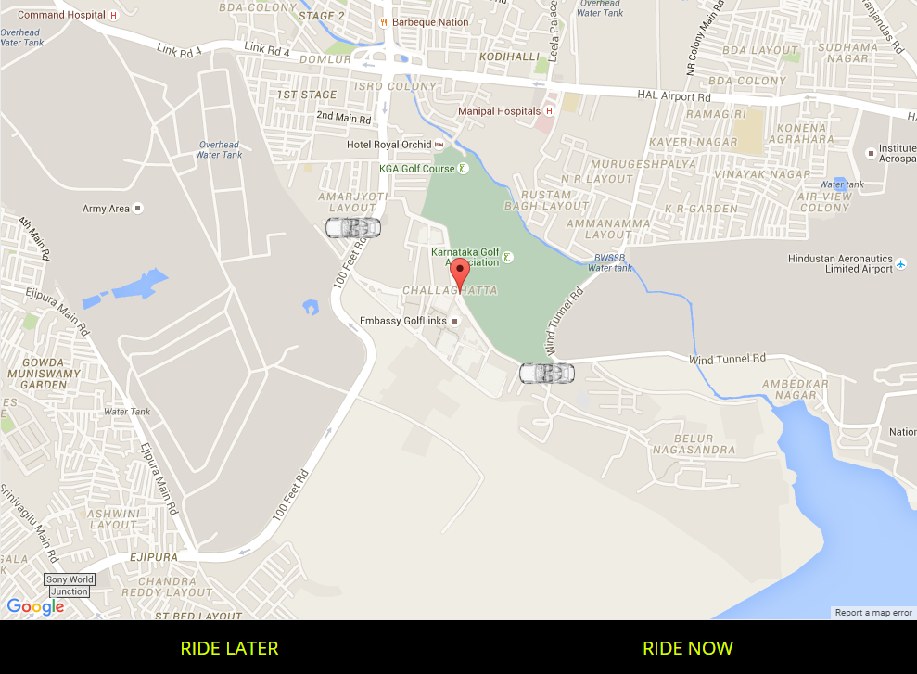
Click to book a ride

Slide 7
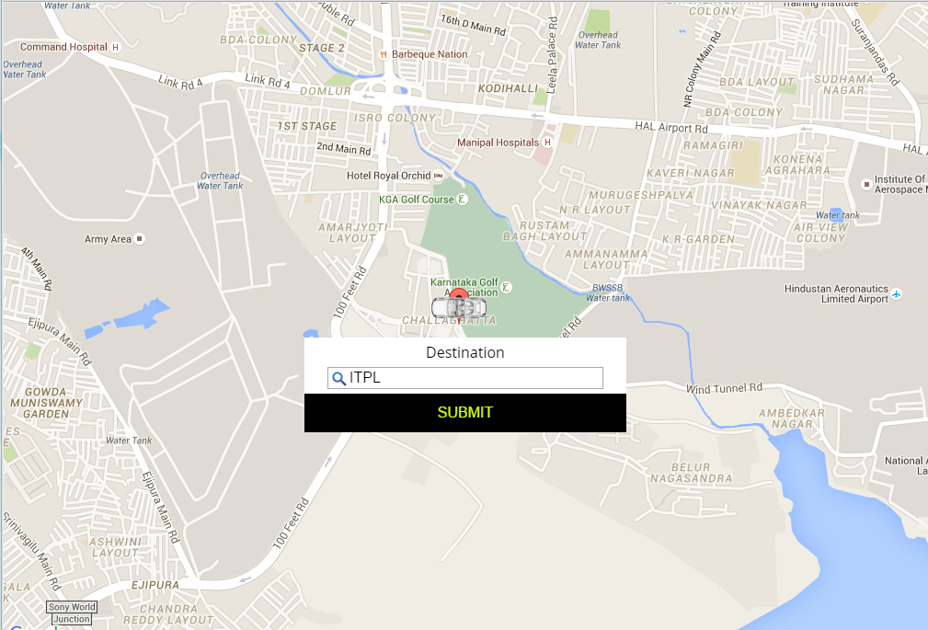
Select destination

Slide 8
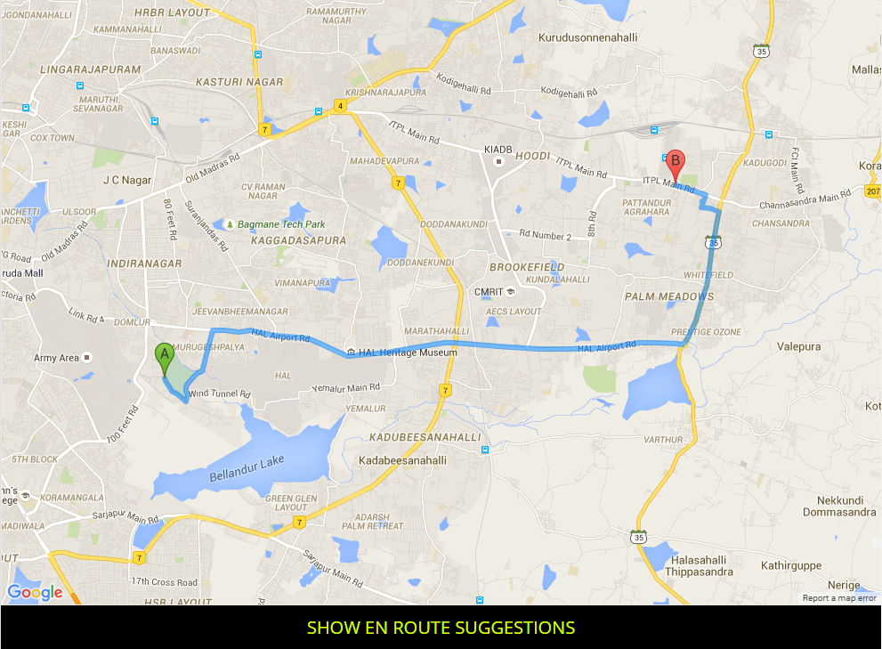
Now click on “Show En route suggestions” This will tell give you suggestions of what services of OLA you can use while in your ride which coincide with the path of your ride.

Slide 9
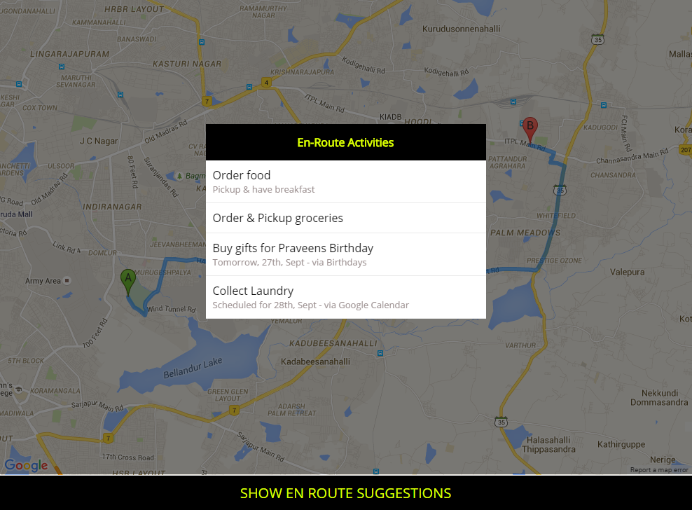
These activities are being fetched from various sources like events and tasks marked on your google calendar, to-do lists, etc.

Slide 10
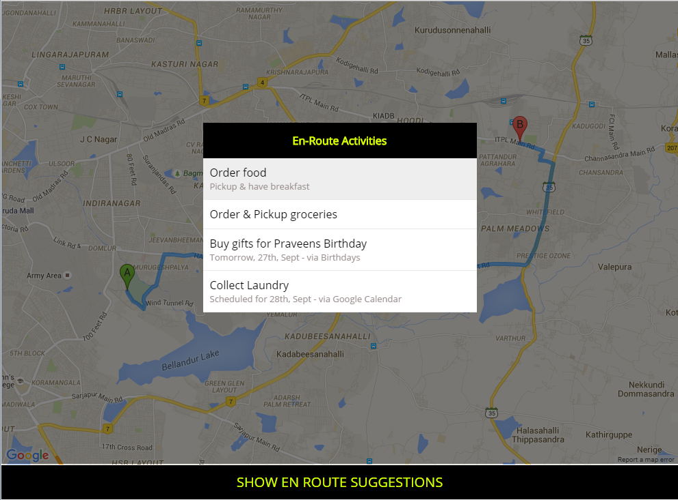
Select one of the activities In this case we select “Order Food”

Slide 11
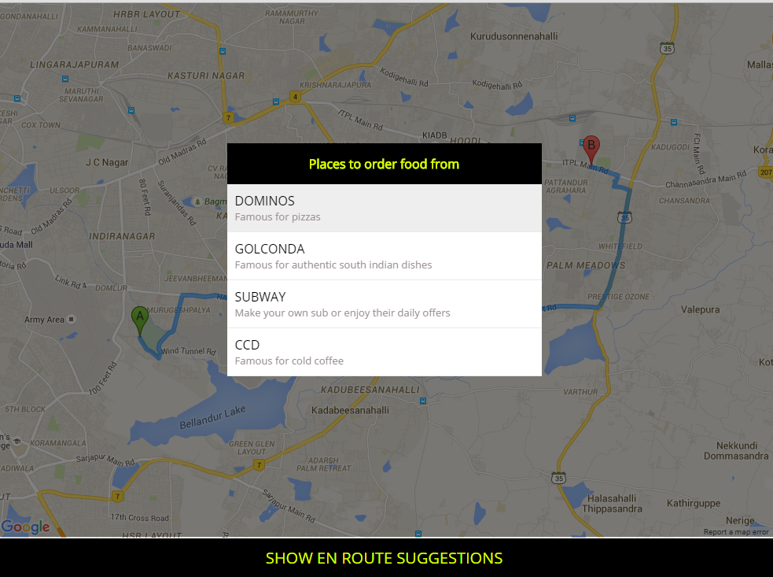
These restaurants will have be registered with OLA as a part of OLA Café. Similarly the other items on the previous slide can be a part of OLA Store (Groceries, cake shop, etc). Note: It will only list restaurants after considering the preparation/delivery time & location of that restaurant (using google places API) and the location of the user when he is about to order Here we select “Dominos”

Slide 12
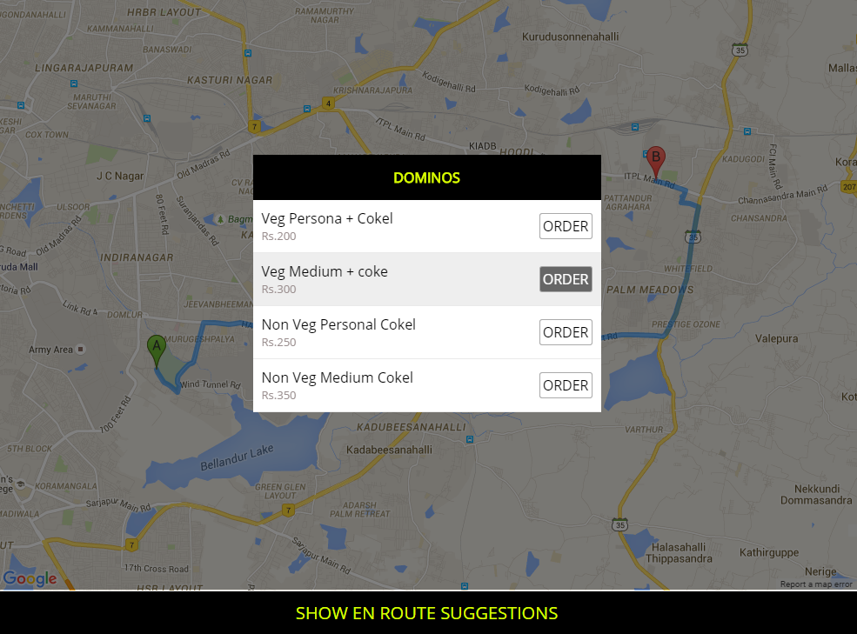
Place the order

Slide 13
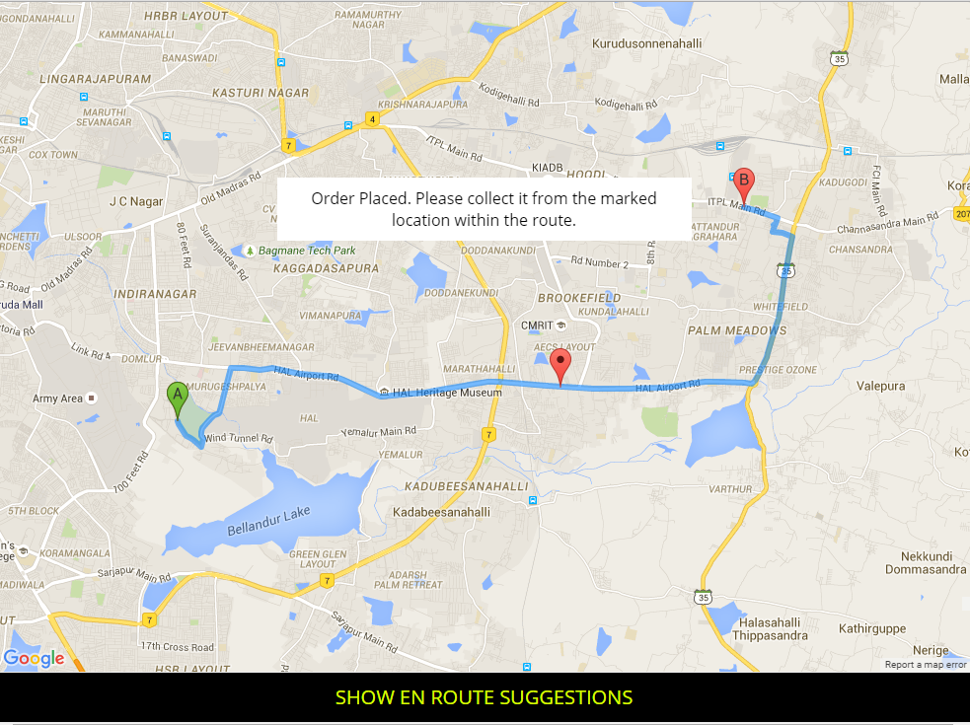
Upon confirmation, receive the location of the activity. You can then collect your parcel accordingly when you reach there.

Slide 14
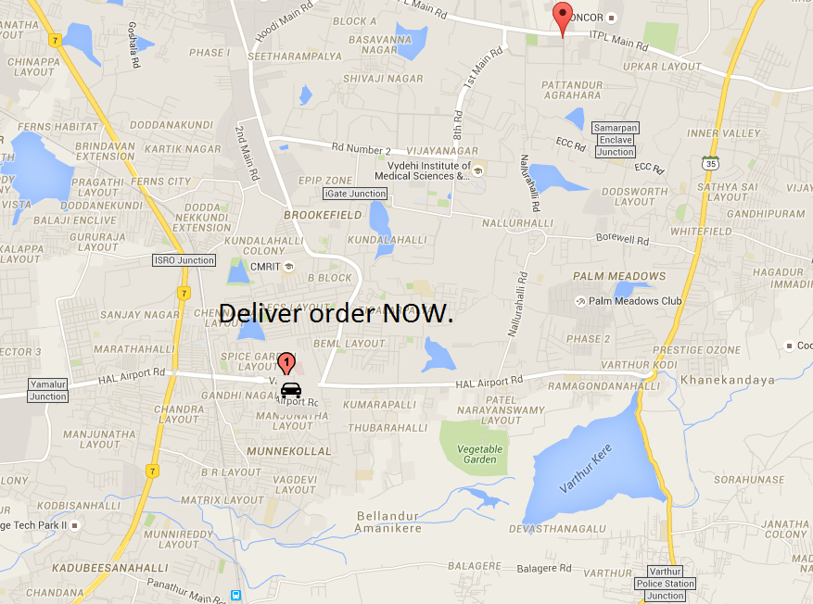
The merchant, who receives the orders, will have a dashboard which will track all the rides with confirmed orders

Slide 15
Payment
Once the customer reaches the merchant, he can pay him via Cash on Delivery OR it could be paid later, directly to OLA ( +Ride Fare ), using OLA money

Slide 16
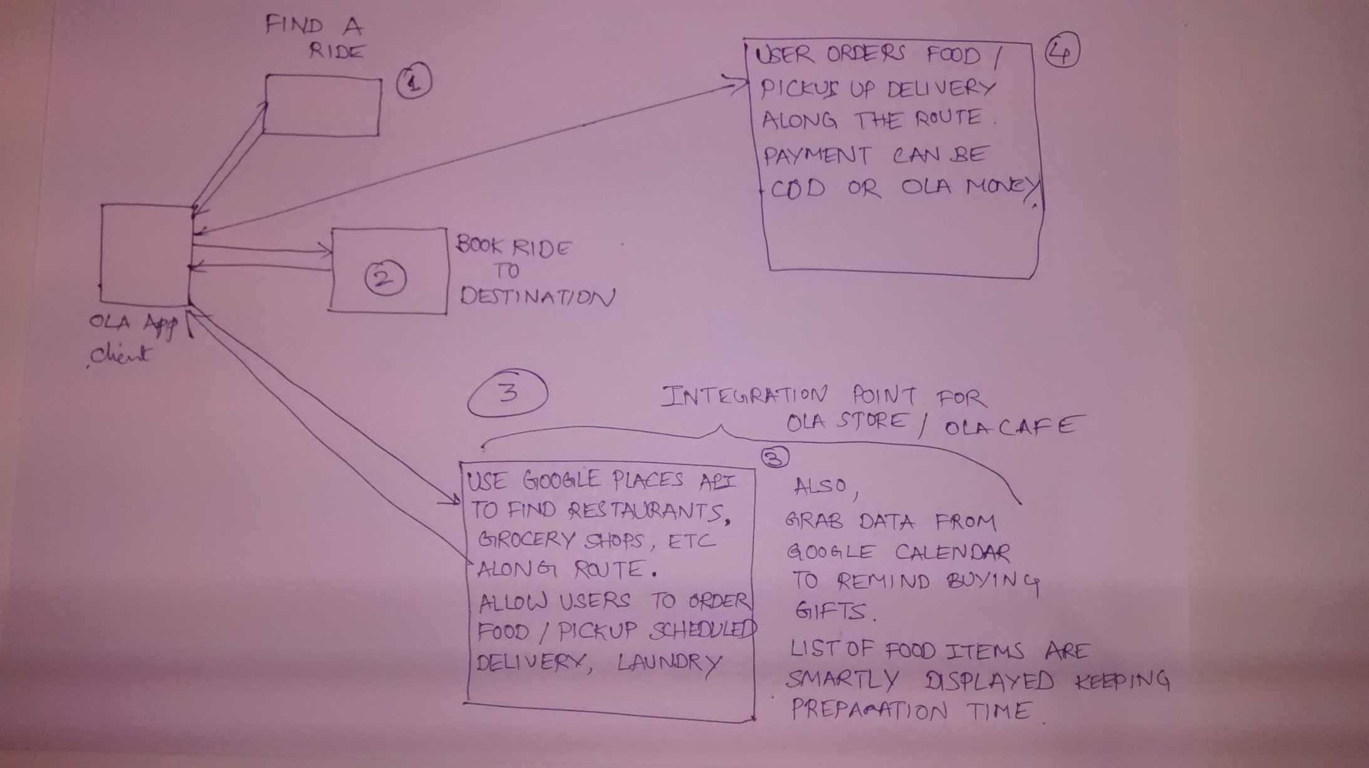
Component Diagram

Slide 17
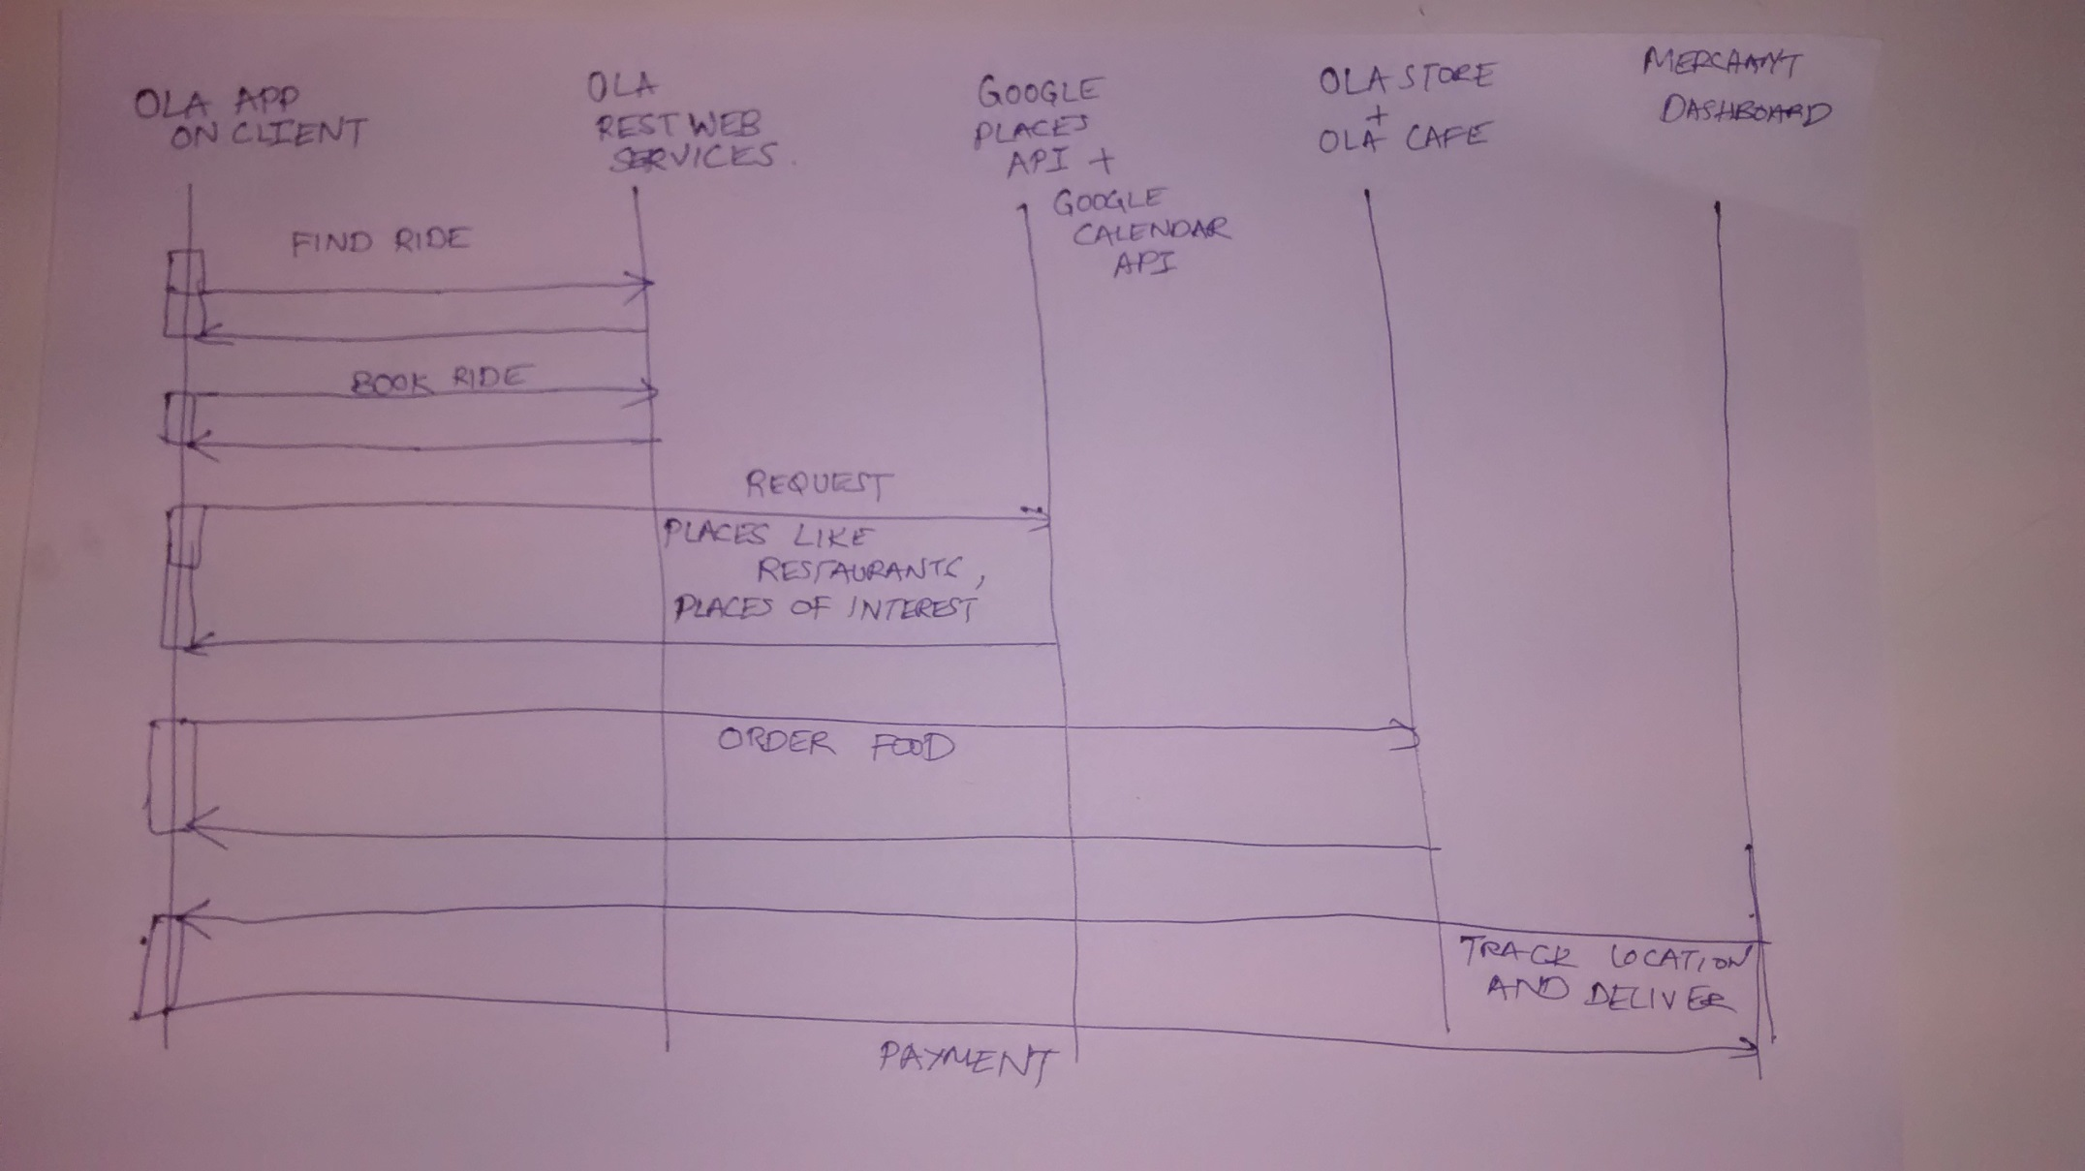
Sequence Diagram

